Slide 1
SICKLE CELL CRISES

Slide 2
PREVALENCE AND DISTRIBUTION
Highest prevalence in tropical Africa and among blacks in countries that participated in the slave trade.
Low prevalence in the Mediterranean basin, Saudi Arabia, and parts of India.
DNA polymorphisms studies suggest it arose from three independent mutations in tropical Africa.
Most common bS chromosome found in Benin and central West Africa.

Slide 3
In some parts of Africa, > 45% of the population have sickle cell trait.
In US, Latin America, and Caribbean ~ 8% of blacks carry the sickle gene.
Before era of hydroxyurea, average life expectancy was in the 40s.
In last century, most pts died before the age of reproduction.

Slide 4
Without selective advantage to Hb S trait, the sickle gene would have been eliminated.
Stability of the sickle gene in Africa is due to balanced polymorphism.
Sickle cell trait has highest prevalence in areas hyperendemic for malaria
Affords selective protection against lethal forms of malaria.

Slide 5
PATHOPHYSIOLOGY
Sickle mutation substitutes Thymine (T) for Adenine (A) in the 6th codon of the ß gene (GAG¬GTG).
This encodes valine instead of glutamine in the 6th position of the ß chain.
Change in structure responsible for changes in molecular stability and solubility-tendency of deoxygenated Hb S to undergo polymerization.

Slide 6
Hb S- so called because of the sickle shape it imparts to deoxygenated rbcs.
Responsible for a wide spectrum of disorders that vary in degree of anemia, frequency of crises, extent of organ injury, and duration of survival.

Slide 7
Physiologic Determinants of Polymerization
Equilibrium of Hb S between its liquid and solid phases determined by:
oxygen tension
Hb S concentration
Temperature
Hemoglobins other than Hb S.

Slide 8
Other Hemoglobins
variable Influence.
Hb A and Hb F - inhibitory effect on gelation
Deoxy-Hb S copolymerizes most effectively with other Hb S molecules, and, in ↓ order, Hb C< D<O< Arab< A< J<F.
These observations predict the clinical severity of disorders involving these variants.

Slide 9
Electrophoretic patterns in common hemoglobinopathies
condition | Hb A | Hb S | Hb C | Hb F | Hb A2
Normal | 95-98 | 0 | 0 | <1 | <3.5
Hb SS | 0 | 85-95 | 0 | 2-15 | <3.5
Hb AS | 50-60 | 35-45 | 0 | <2 | <3.5
Hb SC | 0 | 45-50 | 45-50 | 1-8 | <3.5

Slide 10
Above observations can be used therapeutically by altering Hb S solubility,( modifying polymer structure), lowering MCHC, or ↑ % of Hb F.

Slide 11
Severity
SCD (homozygosity for HbS)>Hb SC disease (combined heterozygosity for Hbs S and C)> sickle cell trait (heterozygosity for HbS).
In sickle cell-ß thalassemia, disease varies with the quantity of Hb A, severe in sickle cell-ß (0) thalassemia and less severe in sickle cell-ß(+) thalassemia.
This difference may not apply to cerebrovascular disease.

Slide 12
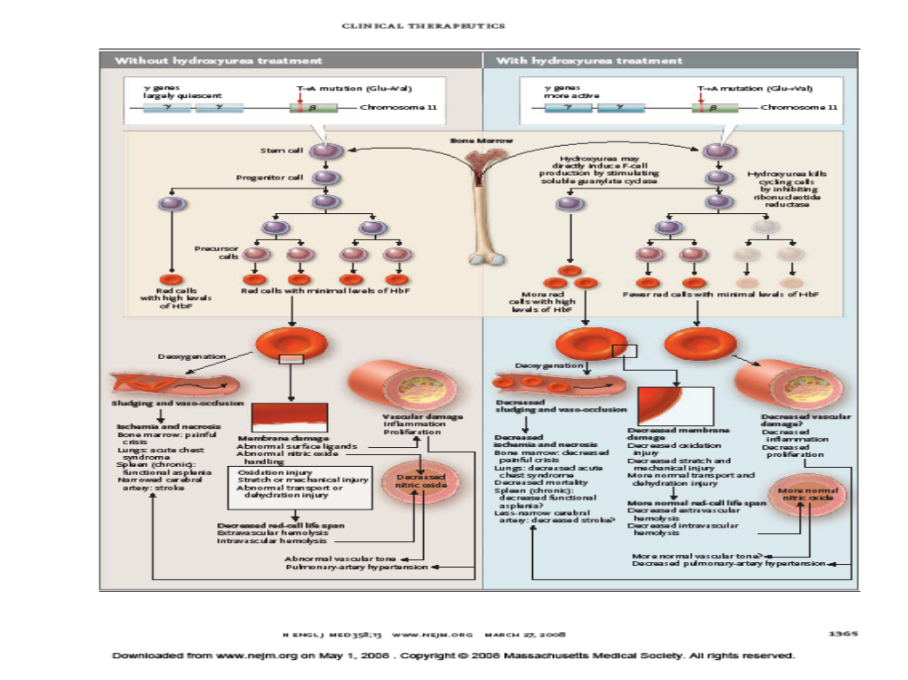

Slide 13
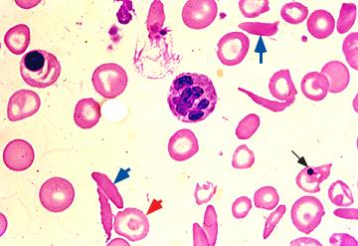
PBF shows multiple spindly sickle cells (blue arrows), nucleated RBC(upper left) and Howell-Jolly body (black arrow), which is a nuclear fragment normally removed by the spleen. Target cells are also present (red arrow).Pt has functional asplenia.

Slide 14
sickle cell crises

Slide 15
Vaso-occlusive Events.
“Sickle cell crisis”- recurring attack of pain involving the skeleton, chest, or abdomen.
vaso-occlusive “crises” -broader term.variety of syndromes that are typically recurrent and potentially catastrophic.
Sudden in onset and are directly attributable to obstruction of the microcirculation by intravascular sickling.
Usually, there is little or no change in hematologic values.

Slide 16
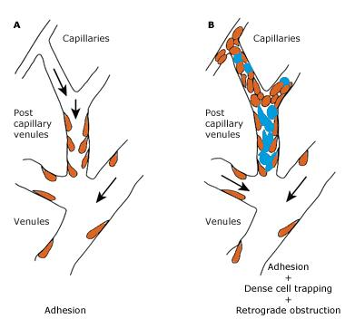
Panel A -adhesion of sickle cells to the vascular endothelium in post-capillary venules and venules.
Panel B - subsequent trapping of dense red cells (in blue) in the partially obstructed post-capillary venules, followed by retrograde obstruction.

Slide 17
Infections often precede vaso-occlusive episodes in children.
Contributing factors:Fever, dehydration, and acidosis.
No seasonal variation in the frequency of crises has been noted.

Slide 18
Painful Crises
Typically, after the first few years of age.
Interruption of blood flow occurs in the larger bones of the extremities, spine, rib cage, and periarticular structures-painful crises of the bones and joints.
The sinusoidal circulation of the bone marrow provides ideal vascular bed for sickling.

Slide 19
Some of these episodes are short-lived and are managed at home.
Frequency of pain peaks between the ages of 19 and 39.
More frequent pain is assd with a higher mortality rate in pts over age 19 -chronic end-organ damage

Slide 20
Provocative factors
Idiopathic
Infection
Fever, excessive exercise
Anxiety
Abrupt changes in temperature
Hypoxia,or hypertonic dyes.

Slide 21
Protean manifestations- intermittent episodes in connective and musculoskeletal structures produce painful ischemia.
Acute pain and tenderness, fever, tachycardia, and anxiety.
Their frequency and severity vary greatly.
Pain can dev almost anywhere and may last from a few hrs to 2 wks.

Slide 22
Repeated microinfarction destroy tissues having microvascular beds that promote sickling.
Spleen is infarcted within the 18 to 36 months of life→ susceptibility to infection, esp pneumococci.
Renal papillary necrosis invariably produces isosthenuria.
More widespread renal necrosis leads to renal failure in adults, a common late cause of death.

Slide 23
Bone and joint ischemia leads to aseptic necrosis (especially of the femoral or humeral heads), chronic arthropathy, and unusual susceptibility to osteomyelitis, which may be caused by organisms such as Salmonella.
The hand-foot syndrome- caused by painful infarcts of the digits and dactylitis.
priapism, due to infarction of the penile venous outflow tracts; permanent impotence is a frequent consequence.

Slide 24
In the CSSCD study-average rate of pain was 0.8 episode per pt-yr in Hb SS, 1.0 episode per pt-yr in Hb Sb0 thalassemia, and 0.4 episode per pt-yr in Hb SC and Hb Sb+ thalassemia.
Rate varied widely from pt to pt: 39% of pts with SCA- no episodes of pain, but 1% had more than 6 episodes per yr. 5% Hb SS pts accounted for 1/3 all episodes.
The pain rate ↑ moderately from childhood to the third decade of life.

Slide 25
Pain resulting from ischemia of the bone marrow is gnawing and progressive in severity.
Most frequent sites: humerus, tibia, and femur . Facial bones is less common.
Swelling associated with infarction of the orbital bone may produce proptosis and ophthalmoplegia.
Swelling of the elbows or knees may mimic rheumatic fever or septic arthritis.

Slide 26
Infarcts of deep bones and joints are not associated with detectable swelling, erythema, or surface temp change.
Lab findings-inconstant and nonspecific.
X-ray features of bone infarction and periostitis do not appear until after the resolution of symptoms.

Slide 27
As a cause of bone pain, infarction is> 50 times as common as osteomyelitis
MRI and scintigraphic techniques permit early documentation of bone and marrow involvement.

Slide 28
Abdominal pain crises- infarcts of the mesentery and abdominal viscera
Severe abdominal pain and signs of peritoneal irritation.
Pattern of pain tends to repeat itself from crisis to crisis.
Atypical clinical or lab features suggest complications to which SCA pts are prone to e.g acute chest syndrome, UTI or cholecystitis.

Slide 29
On average, painful crises persist for 4-5 days.Protracted episodes may last for wks.
↑ frequency of painful events is associated with a high hct and a low Hb F.

Slide 30
Hand-Foot Syndrome
Initial episode in young children.
Often involves small bones of hands and feet( hand-foot syndrome).
Dorsa of the hands and feet swollen, nonerythematous, and exquisitely painful.
Fever and leukocytosis common.
X-ray changes are limited initially to soft tissue swelling.

Slide 31
Cortical thinning and destruction of metacarpals, metatarsals, and phalanges appear 2-3 wks after the onset of symptoms.
Sudden in onset and usually lasts 1 or 2 wks.
May recur on one or more occasions until the patient is about 3 years of age.

Slide 32
Rx
Treat precipitants of the crisis.
Infection, requires antibiotic therapy.
Hydration
O2 therapy in the absence of documented hypoxemia is without benefit and triggers an ↑in the no of ISC when discontinued .

Slide 33
Pain control - liberal use of analgesics .
narcotic addiction is unlikely as long as the use of analgesics is closely monitored.
Benefit from adjunctive therapy with a short course of steroid or a long acting NSAID (e.g ketorolac)
Blood transfusions do not modify the course of an established crisis

Slide 34
Acute chest syndrome
The acute pulmonary complication- acute chest syndrome.
Includes pneumonia, infarction due to in situ thrombosis, and embolic phenomena due to fat embolism and bone marrow infarction.
Most common form of acute pulmonary disease in SCD, occurring in 30 to 50 percent of pts.

Slide 35
Presents as chest pain, a new infiltrate on CXR and fever, usually without bacteremia.
Most frequent cause of death in adults and is a risk factor for early mortality.
The frequency of asthma is high in this setting.
Complications include PHT and chronic lung disease.

Slide 36
Etiology- vaso-occlusion but infarction, embolism, and infrequently bacterial pneumonia are precipitating causes.
Infection common in children.
Bacteremia is present in 3.5 percent of cases, particularly in infants.

Slide 37
working definition of ACS
Presence of the following:
new pulmonary infiltrate, involving at least one complete lung segment (not atelectasis)
Chest pain
Temperature >38.5ºC
Tachypnea
wheezing, or cough

Slide 38
Etiology
Unknown cause — 46 percent overall
Fat embolism 16% with or without infection
Chlamydophila — 9 %
Pneumoniae infection — 7 %
Mycoplasma pneumoniae — 7 %
Viral infection — 6%
Mixed infections — 4%
Other pathogens — 1 %

Slide 39
Most infections are community-acquired pneumonia.
Infarction results from in-situ thrombosis due to intravascular sickling and occlusion in the microvasculature.
Hypoxia-induced adhesion of sickle RBCs to the pulm endothelium mediated by VCAM-1 , endothelin-1, cell-free hb, and NO metabolites.
↑ levels of F2 isoprostanes,(markers of free radical catalyzed lipid peroxidation),showing↑ oxidative stress.

Slide 40
Pulmonary fat embolism - Bronchoalveolar lavage fluid findings of greater than 5% lipid laden mǿ found in 50 to 60% of children and adults with ACS
Patients with PFE complain of bone pain and may develop neurologic symptoms.

Slide 41
Clinical findings
Fever, chest/ extremity pain, dyspnea, and nonproductive cough.
Chest- local tenderness over the ribs or sternum,lung consolidation.
Lab: Leukocytosis Thrombocytopenia or thrombocytosis ,Falling Hb,↑ LDH and bilirubin levels
CXR-normal in 30% on adm, later most pts dev lower lobe infiltrates ( bilateral in 1/3). Pleural effusions 25-35%of pts.

Slide 42
Differentiation of pulmonary infarction due to thromboembolic phenomena from ACS remains problematic.

Slide 43
Treatment
Acute Rx- usually supportive.
Antibiotics to cover for community acquired and atypical organisms .
Supplemental O2-prevents further intravascular sickling.
Opioid analgesics- used judiciously to avoid potential respiratory depression.

Slide 44
2/3 of pts with SCD have ↑ airway reactivity .
Use inhaled ß agonist in pts with wheezing, severe resp distress, clinical or x-ray evidence of hyperinflation, or prior h/o asthma or obstructive airway disease.

Slide 45
vigorous hydration in combination with opioid analgesics can lead to pulmonary edema.
frequent clinical evaluation of these pts is required, and the maintenance of a euvolemic state is the Rx goal.

Slide 46
Exchange transfusion- setting of progressive infiltrates and hypoxemia refractory to conventional RX.
↓of HbS level to <30%, hct of ~ 30 percent%, leads to marked improvement in majority.
empiric anticoagulant RX not recommended unless thromboembolic phenomena documented-↑risk of intracranial and renal bleeding.

Slide 47
inhaled nitric oxide (NO)&oral Arginine - under investigation.
Acts by ↓ adhesion of sickle rbcs to pulmonary endothelium.

Slide 48
Preventing recurrence
Chronic therapy prevents recurrent episodes and devt of sickle cell chronic lung disease (SCCLD).
Penicillin prophylaxis is recommended in children aged 4 mo to at least 3 years.
Pneumococcal vaccine .
Chronic transfusions ↓the frequency of ACS episodes.
Hydroxyurea -↓ painful crises and episodes of ACS by 50 percent .

Slide 49
CNS Events
Stroke is a catastrophic complication affecting 6 to 17% of children and young adults .
Two major syndromes observed:
occlusion of major cerebral vessels.Affects children 2-15 yrs.
Intracerebral/ subarachnoid arneurysmal hemorrhage. Affects older children and adults .

Slide 50
Risk ↑ in pts with Hb F levels of less than 8% and in pts with siblings who have had strokes
Pathogenesis not clear.
In 80%,occlusion or stenosis of major cerebral arteries , sometimes with prominent collateral circulation through the basal ganglia producing a so-called moyamoya pattern.

Slide 51
Pathology
Vascular narrowing due to segmental proliferation and fragmentation of the intima.
progressive proliferation, superimposed thrombosis, or an embolus→occlusion
Adherence of sickle RBCs to the endothelium of vessel walls.
Forceful separation of adherent RBCs by shear forces in arteries exposes subendothelial structures- nidus for platelet aggregation, and thrombus formation.
Aneurysms-cause haemorrhage

Slide 52
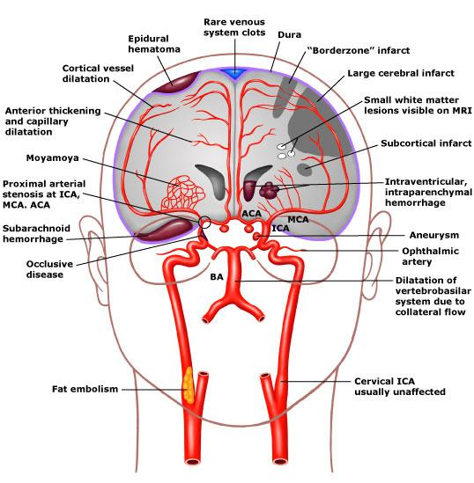
Common compxs are cerebral infarcts in major vessels and "borderzone" infarctions. "Borderzone" infarctions are most common in the areas between the MCA&ACA and between middle and posterior cerebral arteries.
Fat embolism and venous side abnormalities are the least common lesions. Small white matter lesions visualized on MRI can be seen in asymptomatic pts. Aneurysms often multiply within the "circle of Willis". ICA: internal carotid artery, BA: basilar artery.

Slide 53
Presentation
Abrupt onset of hemiparesis, aphasia, seizures, sensory deficits, and altered consciousness
May occur singly or together.
Triggering event rarely encountered.
Although the pt may make a full recovery, incomplete resolution of neurologic deficits is the rule.

Slide 54
Strokes tend to be repetitive because of the progressive nature of cerebral vascular disease.
Unless on long-term transfusion program, there is risk of recurrent CVAs with progressive neurologic deterioration.
Chronic transfusion to maintain Hb S <30% slows progression of arterial abnormalities and ↓ risk of recurrent strokes (within 36 months) from ~ 70 to 90% to 10%.

Slide 55
Interrupting RX, even after yrs of chronic transfusion, associated with recurrence rate similar to untransfused pts.
Thus transfusion therapy for 2º stroke prophylaxis should be contd indefinitely.
Many chronically transfused children have their transfusions discont’d when they reach adulthood; there are no reports of the safety of this approach.

Slide 56
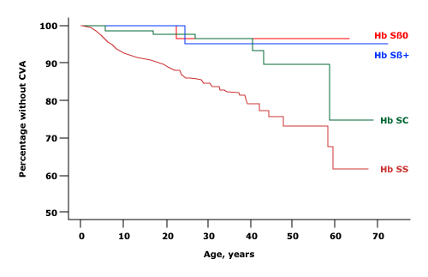
Age at 1st CVA and cumulative incidence of various Hbs

Slide 57
prevention
identification of children who are at highest risk for stroke
Use transcranial Doppler ultrasound screening

Slide 58
Priapism
Has bimodal distribution of age of onset- peaks at 5-13 and 21-29 yrs.
Timing- normal erections of REM sleep and associated with physiologic dehydration and hypoventilation, which results in metabolic acidosis -sickling and stagnation of blood within the penile sinusoids or the corpora cavernosum.
Engorgement of the paired cavernosal bodies with sparing of the glands and corpus spongiosum (bicorporal).
Tricorporal priapism may occur, esp in postpubertal pts.Associated with poor prognosis .
.

Slide 59
Equal frequency in prepubertal and postpubertal males. Difficult to manage in the latter group.
Repetitive trapping of cells in corpora cavernosa, with or without surgical intervention, may lead to fibrosis of the septa and impotence.
Usually self-limited and of relatively short duration.
Recurrent and may become chronic.
“Stuttering” priapism refers to multiple episodes, each less than 3 hrs in duration, several times a wk.
Usually do not require medical intervention

Slide 60
RX
aggressive hydration and adequate analgesia.
No response in 12 to 24 hrs- partial exchange transfusion to lower the Hb S level to <30%.
This is occasionally sufficient
No resolution in another 12 to 24 hrs- surgical intervention.
Despite above RX> 25% of pts will have some degree of impotence.

Slide 61
Hematologic Crises
characterized by sudden exaggeration of anemia
Pathogenetically and temporally unrelated to vaso-occlusive crises.
If unrecognized or untreated, ↓ in Hb may be so precipitous and severe as to cause heart failure and death within hrs.
Role of malaria in aetiology in some types

Slide 62
Aplastic Crises.
Most common of the hematologic complications.
Pathogenesis and course of aplastic crises in SCA similar to other chronic hemolytic states
preceded by or associated with febrile illnesses.
members of family with congenital hemolytic anemia may have concurrent aplasia

Slide 63
recurrence of crisis within the same individual not observed
most episodes occur during childhood
human parvovirus B19 causes most, if not all, aplastic crises
Aplasia is the result of direct cytotoxicity of the parvovirus to erythroid precursors, especially colony-forming units, erythroid (CFU-E)

Slide 64
Susceptible H/W exposed to pts with aplastic crises at high risk of contracting nosocomial erythema infectiosum
Infection during the midtrimester of preg result in hydrops fetalis and stillbirth- isolation precautions are a necessity if an aplastic crisis is suspected

Slide 65
Course
early phase - peripheral blood reticulocytes and bone marrow normoblasts disappear or are greatly reduced in number.
cessation of erythropoiesis is followed by a rapid ↓ in Hb.(Red cell survival in HbS 10- 20 days)
Self-limited
Within 5-10 days, RBC production resumes→ reticulocytosis and nucleated RBCs in peripheral blood.

Slide 66
Often, the patient is first seen early in recovery phase-so differentiation from a hemolytic crisis may be difficult.
Although leukocytes and platelets are usually normal, all marrow elements may be affected .
Rx- supportive care with red cell transfusion when necessary.

Slide 67
Splenic Sequestration
characterized by sudden trapping of blood in the spleen.
defined by a ↓ in the steady-state Hb >2 g/dl, evidence of compensatory marrow erythropoiesis, and an acutely enlarging spleen.
occurs in infants and young children whose spleens are chronically enlarged before autoinfarction and fibrosis.
commonly in second 6 months of life and rare after 2 yrs.
has been documented in infants as young as 3 and 4 months of age .

Slide 68
presentation
may have an earlier onset of splenomegaly and a lower level of Hb F at 6 months of age.
often associated with respiratory tract infections or rarely, parvovirus B19 in conjunction with an aplastic crisis .
Already enlarged spleen rapidly ↑ in size at the expense of blood volume; hypovolemic shock and death may occur within hrs.

Slide 69
Pertinent pm finding is engorgement of splenic sinusoids with sickled cells.
Survivors have a tendency for recurrent episodes until 5 or 6 years of age, by which time fibrosis of the spleen has occurred to limit its expansion.
Rarely, sudden trapping of blood in the liver (hepatic sequestration crisis) also may occur.

Slide 70
Hyperhemolytic Crises.
sudden acceleration of the hemolytic process.
Described in association with hereditary spherocytosis and mycoplasma infection.
Rare in G6PD,due to young mean age of sickle RBCs.
Increased lipid peroxidation of sickle RBCs by reactive O2 species derived from activated neutrophils is another possible mechanism for infection-associated hemolytic crises.

Slide 71
Megaloblastic Crises
sudden arrest of erythropoiesis by folate depletion .
Chronic erythroid hyperplasia imposes a drain on folate reserves .
occurs when food intake is interrupted by illness, alcoholism or when the folate requirement is augmented by rapid growth or pregnancy.
Rare- due to common practice to give prophylactic folate (1 mg/day) to pts with SCD

Slide 72
Infections
Overwhelming infection may be the presenting manifestation of SCA in early childhood.
common cause of hospitalization and death esp in first 3 yrs of life.
Commonly by S. pneumoniae.Blood and spinal fluid are the major sites.
penicillin prophylaxis has substantially lowered the risk of invasive pneumococcal infection.

Slide 73
After 5 yrs, the incidence of life-threatening infections ↓ substantially.
Gram-ve bacteria replace S. pneumoniae as the major offenders.
older children and adults have an identifiable source or focus (e.g., E. coli - urinary tract infection).
Osteomyelitis, often involving multiple sites, occurs with increased frequency at all ages.

Slide 74
↑ risk of osteomyelitis due to frequent tissue ischemia and infarction- nidus for infection in the long bones
Although > 80% of hematogenous osteomyelitis in the general popn is staphylococcal, most cases in SCA are caused by Salmonella.
Staphylococcal bone infection, clinically indistinguishable from Salmonella infection, also occurs with equal frequency.

Slide 75
Increased susceptibility to aggressive infection due to:
-Hyposplenism
-↓complement activation
-↓ IgM

Slide 76
General management of SCD
Two major components:
RX and prevention of the acute manifestations of SCD
Specific therapies that interfere with sickle Hb polymerization process (eg, increasing sickle cell hydration or increasing the production of Hb F)

Slide 77
REACTIVATION OF HB F SYNTHESIS
Enhanced concns of Hb F have a marked inhibitory effect on sickling and improve the clinical course of SCD.
Erythropoietin and hydroxyurea work by recruitment into proliferation and differentiation of a popn of erythroid precursors which retain the γ-chain synthesis program but remain dormant in the bone marrow of the adult unless called up in cases of acute erythroid expansion

Slide 78
several agents increase the level of Hb F,but only hydroxyurea has significant clinical effects in terms of reduction of pain crises, chest syndrome, and transfusions in pts with SCD.

Slide 79
Hydroxyurea
inhibits ribonucleotide reductase, blocking DNA synthesis and cell division.
enhances fetal hb by developing erythroid cells
induces fetal Hb production, ↑red cell MCV and ↓no.of dense cells and ISCs in circulation

Slide 80
First (and only) drug proven to prevent sickle cell crises.
does not cure SCD nor is it effective in all pts
modifies the characteristics of RBCs in pts with homozygous HbS disease to resemble those of pts with HbSC disease

Slide 81
Pts should be carefully screened and meet certain criteria:
Age - >18 yrs.
Frequent painful vaso-occlusive crises- > 3 crises per yr that require hospitalization.
Use of accepted modes of contraception to prevent conception while on the drug

Slide 82
contraindications
few vaso-occlusive pain crises
Pregnancy
Allergy to the drug
Thrombocytopenia or neutropenia

Slide 83
not approved for use in children.
An NIH-sponsored trial of the drug in children is on-going.
A number of issues have been raised regarding hydroxyurea in children, including neurocognitive development and bone maturation

Slide 84
relatively nontoxic
myelosuppressive effects are readily reversible
May ↑ incidence of AML in pts with polycythemia vera

Slide 85
moderate/severe disease: Initial: 15 mg/kg/day, ↑by 5 mg/kg every 12 wks if blood counts are in an acceptable range until the max tolerated dose of 35 mg/kg/day or the dose that does not produce toxic effects
erythropoietin can be added in pts not responding to hydroxyurea alone

Slide 86
Hematopoietic cell transplantation- currently offers the only hope for cure of SCD
-experience is limited.
Gene therapy -potential to cure SCD.Still experimental
Reduction of intracellular Hb-clotrimazole,Mg.

Slide 87
Infection control and prophylaxis
early recognition of infection and the palpation of enlarging spleens to permit early detection of potentially fatal splenic sequestration crisis .
Immunize against Strep pneumoniae, Hi B, HBV and influenza.
Response to pneumococcal capsular polysaccharide vaccine generally poor.
New conjugate pneumococcal preparation superior in pts with SCD

Slide 88
Prophylactic penicillin- 125 mg pen V P.O BD daily until 2-3 yrs and 250 mg BD daily thereafter until 5 yrs.
Pneumococcal sepsis does occur in pts on penicillin who have received the pneumococcal vaccine; is associated with suboptimal compliance with penicillin prophylaxis .

Slide 89
Routine Rxs and evaluations
Folate- orally 1 mg/day .
Cerebral blood flow - evaluate by transcranial Doppler and incidence of stroke reduced by chronic transfusion therapy.
Retinal evaluation is begun at school age and continued routinely to detect early proliferative sickle retinopathy.
Sexually active women should have routine pelvic examinations and birth control.

Slide 90
Pain management
-aggressive pain relief using opiates, other analgesics, or other modalities.
-optimal hydration by oral or iv fluid resuscitation
-Patients are often undertreated for pain!
Consequence- duration of painful episodes prolonged, "drug-seeking" (pain-relieving) behavior pattern encouraged, and a pain-oriented personality evolves.

Slide 91
Opiates
Iv morphine, followed by rescue or maintenance analgesia such as patient-controlled analgesia.
Pts with SCD metabolize opiates rapidly, a factor that must be taken into account when assessing the response to therapy.

Slide 92
Morphine -0.1 to 0.15 mg/kg every 3 to 4 h) or meperidine (0.75 to 1.5 mg/kg every 2 to 4 h) should control severe pain.
Fentanyl- synthetic derivative of morphine.
100 times more potent.
more lipid-soluble than morphine
More rapid onset of action, due to improved penetration of BBB
Shorter t1/2 of 2-3 hrs.
Administered as a continuous iv infusion.

Slide 93
Newer approaches
Use of potent NSAIDs, opioid receptor-binding agents, surfactants that inhibit cell adherence and aggregation, inhaled NO, anticoagulants, glucocorticoids, and epidural anesthesia

Slide 94
Ketorolac(Toradol®)- potent NSAID.
Given by injection or orally.
Causes no respiratory depression
Effective for relieving bone pain in pts with SCD
Should be limited to a 5 day course and should be given with H2 blockers because of severe GIT side effects. I.V.: Initial dose: 0.5 mg/kg followed by 0.25-1 mg/kg every 6 hours for up to 48 hours; maximum daily dose: 90 mg
Oral: 0.25 mg/kg every 6 hours

Slide 95
I.V.: Initial dose: 0.5 mg/kg followed by 0.25-1 mg/kg every 6 hours for up to 48 hours; maximum daily dose: 90 mg
Oral: 0.25 mg/kg every 6 hours

Slide 96
Tramadol - centrally acting analgesic
Adm orally.
Binds to the mu-opioid receptor, inhibits norepinephrine and serotonin reuptake, and induces minimal respiratory depression.
Low potential for abuse or addiction, relieves postoperative pain efficaciously
Useful in OPD mx of pain crises.

Slide 97
NSAIDs can impair kidney function and accelerate the renal injury produced by SCD itself.
For these reasons, many specialists avoid NSAIDs in patients with sickle cell disease.

Slide 98
Transfusion therapy
Chronic RBC transfusion lowers % of HbS by 3 ways:
-dilution
-suppression of erythropoietin release secondary to the rise in hct
-longer circulating lifespan of normal RBCs.

Slide 99
Indications
-improve O2 carrying capacity and as blood volume replacement during an aplastic or splenic sequestration crisis.
-provide protection from imminent danger during acute chest syndrome or septicemia.
-improve rheologic properties of blood and prevent initial or recurrent cerebral thrombosis
-prevent recurrent priapism, and reduce perioperative complications

Slide 100
Simple transfusion is used for single transfusions to restore O2 carrying capacity or blood volume
Partial exchange transfusions-for acute emergencies and for chronic transfusion because of the improved viscosity effects and reduced iron burden.
Regardless of the technique, Hb should not be raised >10 g/dL because of ↑in viscosity and the risk of vasoocclusive episodes.

Slide 101
Management of infection
Empirical use of antibiotics e.g during febrile episodes
Evidence based use of specific therapies

Slide 102
G-CSF
Its use in pts with sickle cell syndromes (eg,SCA,HB SC and S/beta+ thalassemia) is associated with sickle cell crisis and multiorgan failure
G-CSF may also play a role in the acute chest syndrome
G-CSF administration is absolutely C/I in pts with SCD.
Safe in pts with sickle cell trait

Slide 103
Prediction of adverse outcomes
Potentially curative treatments e.g HCT should be initiated before there is irreversible organ damage.
This requires ability to distinguish pts at high risk as early as possible.
Early dactylitis before age of 1 yr,Hb <7 g/dL and Leukocytosis in the absence of infection are associated with bad outcomes

Slide 104
Acute chest syndrome, renal failure, seizures, a baseline WBC count >15,000/microL, and a low level of Hb F associated with an increased risk of early death.

Slide 105
Causes of death
Infection — 48 %
Stroke — 10 %
Complications of therapy — 7%
Splenic sequestration — 7 %
Thromboembolism — 5%
Renal failure — 4%
Pulmonary hypertension — 3%

Slide 106
Thank you

